Slide 1


Lab 6
Softmax Classifier
With PyTorch 0.2.0_2
Sung Kim <hunkim+ml@gmail.com>
Code: https://github.com/hunkim/DeepLearningZeroToAll/

Slide 2
Lab 6-1
Softmax Classifier
With PyTorch 0.2.0_2
Sung Kim <hunkim+ml@gmail.com>
Code: https://github.com/hunkim/DeepLearningZeroToAll/

Slide 3
https://github.com/hunkim/DeepLearningZeroToAll/tree/master/pytorch
https://github.com/hunkim/DeepLearningZeroToAll/blob/master/pytorch/lab-06-1-softmax_classifier.py

Slide 4
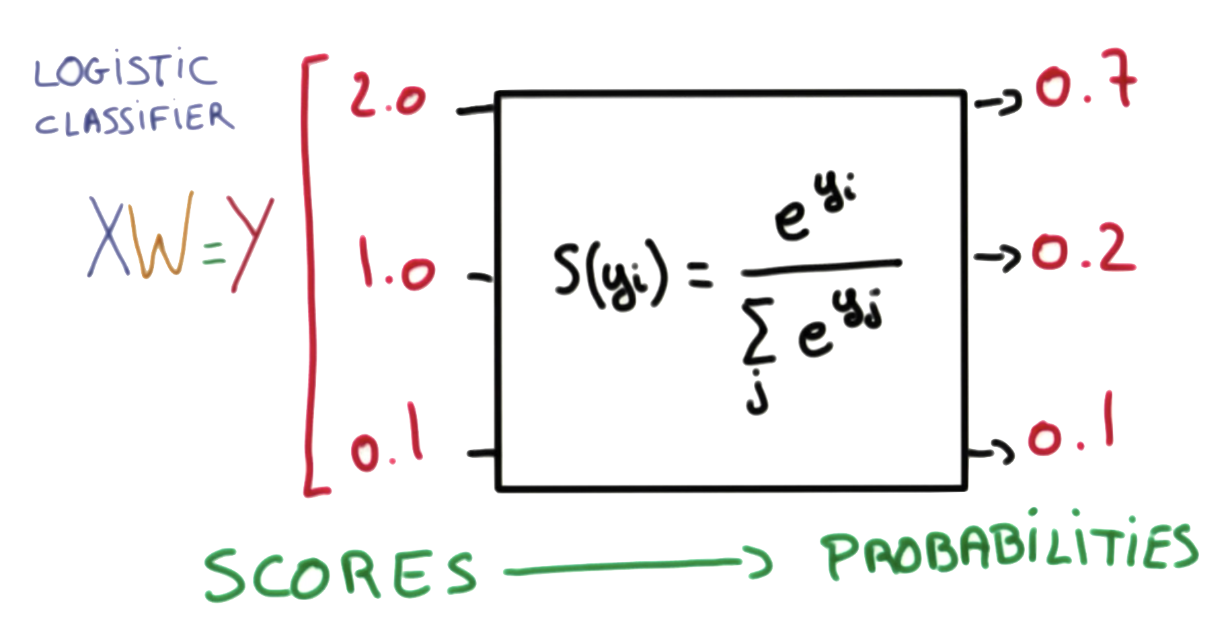
Softmax function
https://www.udacity.com/course/viewer#!/c-ud730/l-6370362152/m-6379811817
Notes:
P(y=i|x) = S(y_{i}) = \frac{e^{y_{i}}}{\sum_{j}e^{y_{j}}} \in (0,1)

Slide 5
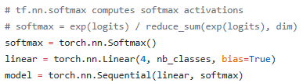
https://www.udacity.com/course/viewer#!/c-ud730/l-6370362152/m-6379811817
https://github.com/hunkim/DeepLearningZeroToAll/blob/master/pytorch/lab-06-1-softmax_classifier.py

Slide 6
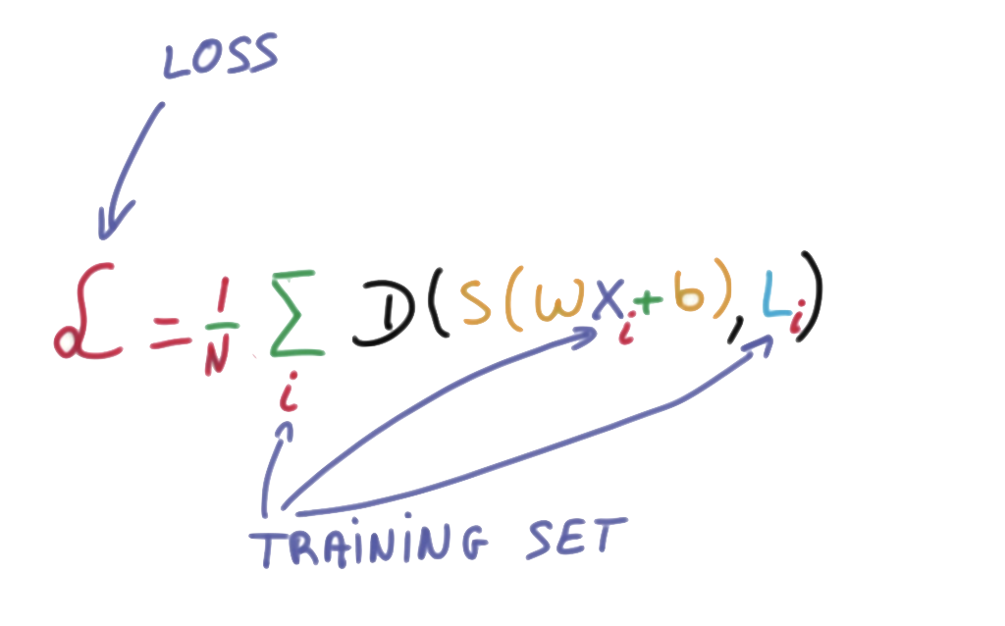
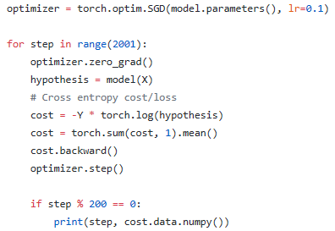
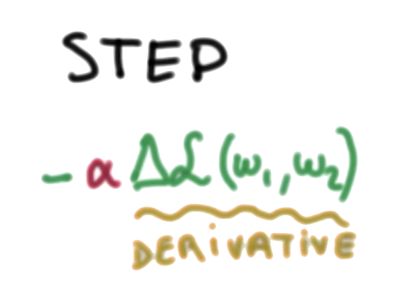
Cost function: cross entropy
https://www.udacity.com/course/viewer#!/c-ud730/l-6370362152/m-6379811817
https://github.com/hunkim/DeepLearningZeroToAll/blob/master/pytorch/lab-06-1-softmax_classifier.py

Slide 7
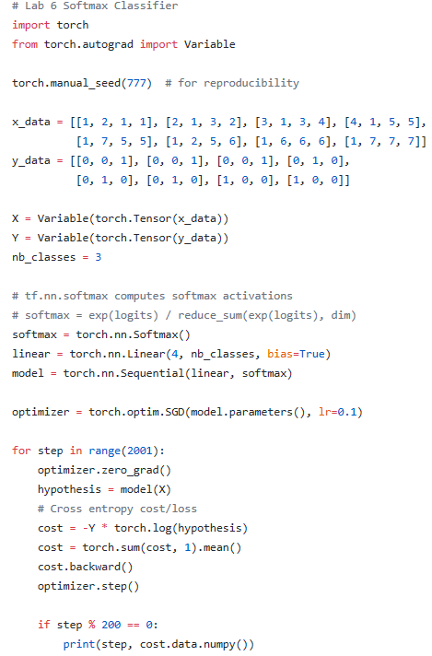
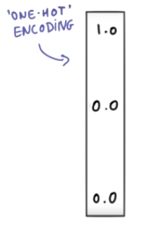
https://github.com/hunkim/DeepLearningZeroToAll/blob/master/pytorch/lab-06-1-softmax_classifier.py

Slide 8

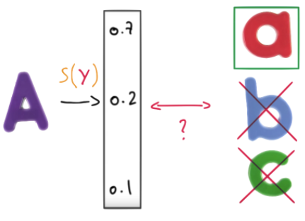
Test & one-hot encoding
[[ 1.38904958e-03 9.98601854e-01 9.06129117e-06]] [1]
https://github.com/hunkim/DeepLearningZeroToAll/blob/master/pytorch/lab-06-1-softmax_classifier.py

Slide 9
Test & one-hot encoding
[[ 1.38904958e-03 9.98601854e-01 9.06129117e-06]
[ 9.31192040e-01 6.29020557e-02 5.90589503e-03]
[ 1.27327668e-08 3.34112905e-04 9.99665856e-01]]
[1 0 2]
https://github.com/hunkim/DeepLearningZeroToAll/blob/master/pytorch/lab-06-1-softmax_classifier.py

Slide 10
Lab 6-2
Fancy Softmax Classifier
cross_entropy, one_hot, reshape
With PyTorch 0.2.0_2
Sung Kim <hunkim+ml@gmail.com>
Code: https://github.com/hunkim/DeepLearningZeroToAll/

Slide 11
https://github.com/hunkim/DeepLearningZeroToAll/tree/master/pytorch
https://github.com/hunkim/DeepLearningZeroToAll/blob/master/pytorch/lab-06-2-softmax_zoo_classifier.py

Slide 12


softmax_cross_entropy

Slide 13
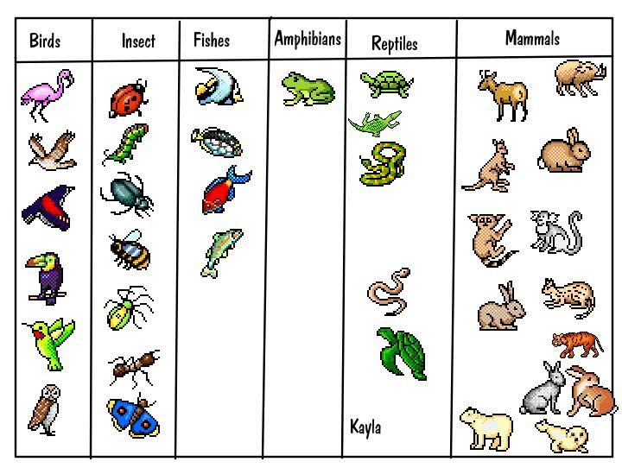
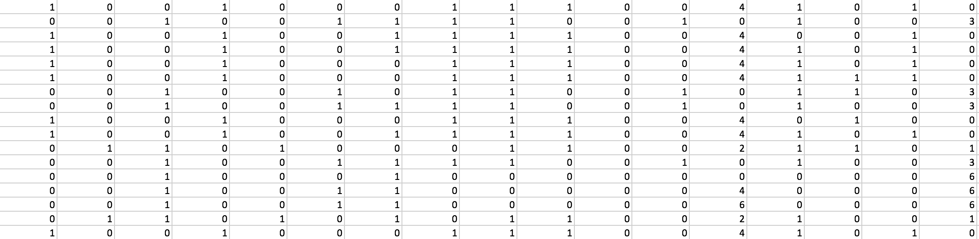
Animal classification
with softmax_cross_entropy
# Predicting animal type based on various features
xy = np.loadtxt('data-04-zoo.csv', delimiter=',', dtype=np.float32)
x_data = xy[:, 0:-1]
y_data = xy[:, [-1]]
https://kr.pinterest.com/explore/animal-classification-activity/

Slide 14
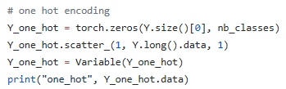
tf.one_hot and reshape

Slide 15
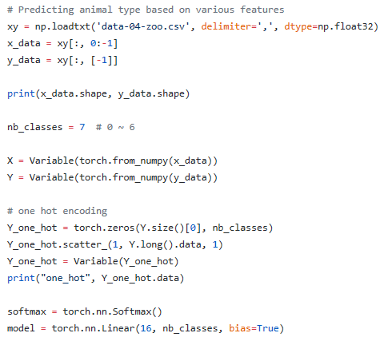
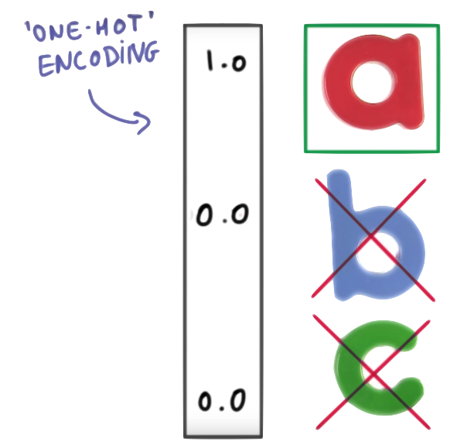
https://github.com/hunkim/DeepLearningZeroToAll/blob/master/pytorch/lab-06-2-softmax_zoo_classifier.py

Slide 16
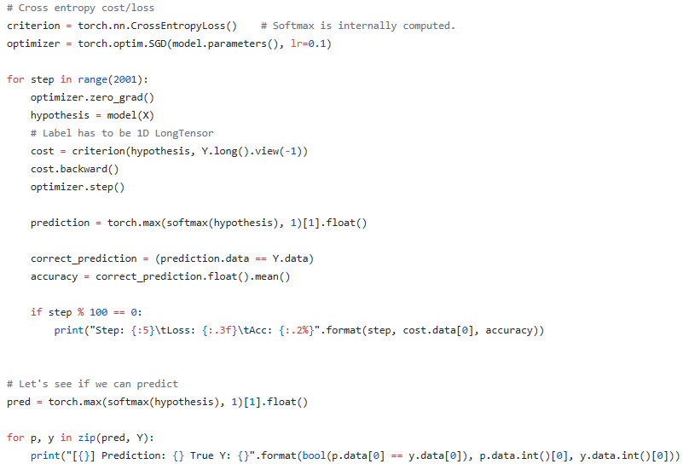
https://github.com/hunkim/DeepLearningZeroToAll/blob/master/pytorch/lab-06-2-softmax_zoo_classifier.py

Slide 17
Lab 9
NN for XOR
With PyTorch 0.2.0_2
Sung Kim <hunkim+ml@gmail.com>

